Slide 1
ME 597: Course Project
Keval Anekar, Aryan Wadhwani and Kushal Doshi

Slide 2



Meet the team
Aryan Wadhwani
Major: Computer Science
Kushal Doshi
Major: Mechanical Engineering
Keval Anekar
Major: Mechanical Engineering

Slide 3
Introduction

Slide 4
Introduction
Development of Solar Farm Specifications for Academic Buildings using Artificial Intelligence

Slide 5
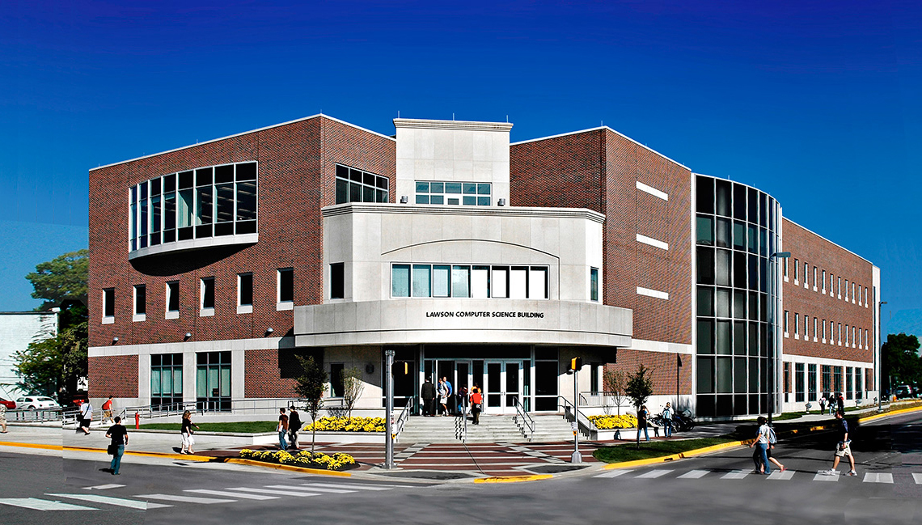
Introduction
Objectives
Predict the electric power consumed by a building over a day
Predict the power produced by a Photovoltaic (PV) cell in a day
Calculate the number of PV cells that would be required to meet the daily electric power consumption for the LWSN building
Notes:
Predict the electric power consumed by a building over a day, given certain details about the building and the weather conditions for that day.
Predict the power produced by a Photovoltaic (PV) cell in a day, given the weather conditions of the day.
Calculate the number of PV cells that would be required to meet the daily electric power consumption for the LWSN building

Slide 6
Introduction
Rationale
Pollution and global warming
Solar power can replace fossil fuels
Predicting effectiveness
Initiate a discussion regarding the benefits of Solar Power
Notes:
This project is important because
Pollution and global warming are becoming more detrimental to our life everyday, and a major cause is non-renewable energy production.
Solar power could be a way to help alleviate the situation.
It is important to predict the effectiveness of a plan before it is implemented, and this project aims to do that.
Results from this project could help initiate a discussion regarding the benefits of Solar Power at Purdue.

Slide 7
Methodology

Slide 8
Methodology
Overview
2 Regression Artificial Neural Network Models
Model 1: Used to predict electricity consumed per day based on given weather conditions
Model 2: Used to predict electricity produced in one day given certain weather conditions
Combination of model 1 and 2 applied to Lawson Computer Science building to find required number of Photovoltaic Cells.
Notes:
Model 1: Used to predict electricity consumed by a university building per day based on given weather conditions and traits of the building
Model 2: Used to predict electricity produced by a single solar panel in one day given certain weather conditions

Slide 9
Methodology
Electricity Consumption Model
Training data:
Weather data from the National Solar Radiation Database (NSRDB)
Electricity consumption for University Buildings
Model trained to predict daily power generation of a building based on weather data and building traits
Tested against validation data, as well as University of Michigan
Applied to Lawson Computer Science Building
Notes:
Weather data from the National Solar Radiation Database (NSRDB) for cities of Berkeley, California and Orlando, Florida
The Electricity consumption: Multiple buildings from Energy Dashboards at University of California Berkeley and University of Central Florida
Model trained to predict daily power generation of a building based on provided weather data and building specifications, such as square feet of the building and type of building
Tested with weather and electricity consumption data for University of Michigan Ann Arbor
Then Used to predict daily electricity consumption for 2019 of the Lawson Computer science building using weather data from NSRDB for West Lafayette from 2019

Slide 10
Methodology
Solar Energy Generation model
Training data:
Weather data from the National Solar Radiation Database (NSRDB)
Daily solar power generation data
Model trained to provide daily power generation
Model used with West Lafayette weather
Notes:
Training data:
Weather data from the National Solar Radiation Database (NSRDB) from the National Renewable Energy Laboratory (NREL) for Amherst, Massachusetts
Daily solar power generation data form University of Massachusetts Amherst’s solar farm on their computer science building
Model trained to provide daily power generation of a single PV cell based on provided weather data.
Used to predict daily electricity generated by a single PV cell for 2019 using weather data from NSRDB for West Lafayette from 2019

Slide 11

Methodology
Purdue Analysis
Calculated power produced by a $n$-panel solar grid
How many panels would be needed?
Which days can the grid meet requirements?
How much of the total power can the solar grid produce?
Notes:
Power produced by $n$ solar panels found by multiplying power production of 1 PV cell by $n$
Using the 2 models we found out on which days the n-panel solar grid met the electricity consumption needs of the Lawson Computer Science building and the total electricity generated by them.
Identified the number of days for which power produced would match or exceed the power produced
Selected number of PV cells that would meet the energy requirements of the building one day of the year, 50%, 75% and 100% of days in the year.

Slide 12
Model Performance

Slide 13
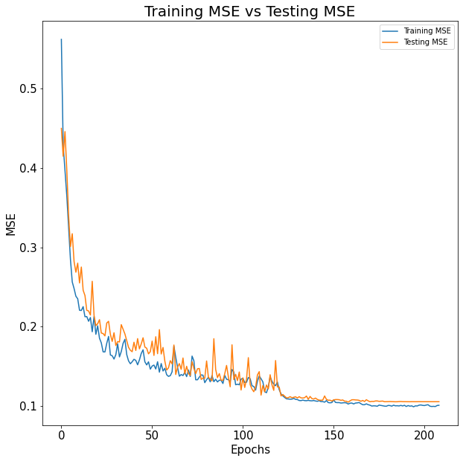
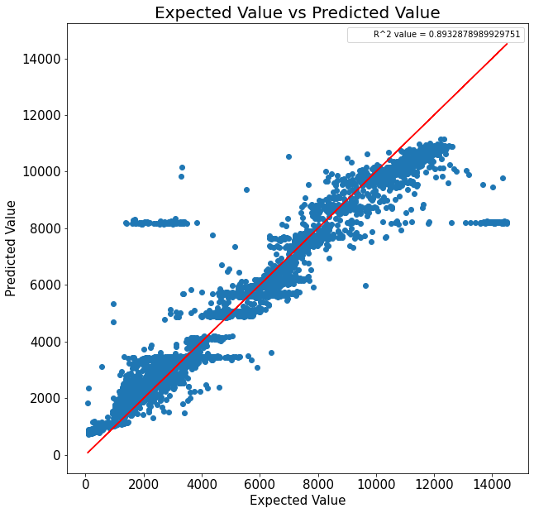
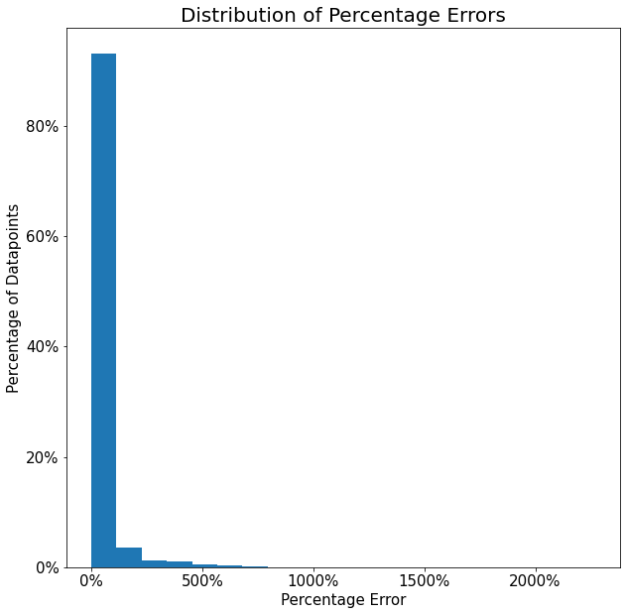
Model Performance
Electricity consumption model
Training and testing MSE for the models against epochs
Predicted vs expected power consumption for the Testing data
Distribution of percentage errors for the Testing data
Notes:
R^2 value of 0.896
MSE of 0.089
For University of Michigan
We also found a mean percentage error difference of just 11%, and this is for data that comes from a completely unseen dataset.

Slide 14
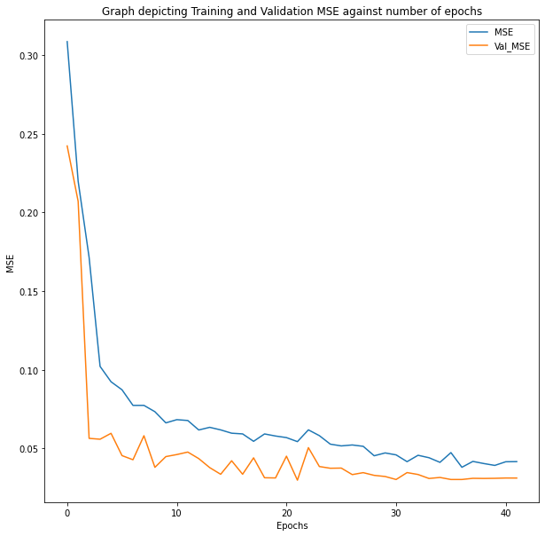
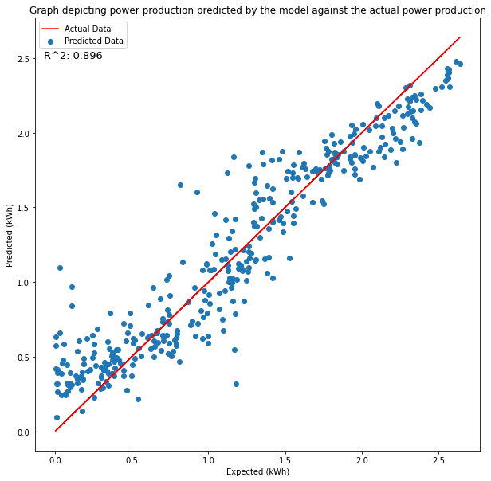
Model Performance
Solar power generation model
Training and testing MSE for the models against epochs
Predicted vs expected power production for the testing data
Notes:
It fit the testing data easily
mean squared error (MSE) of 0.0380 on the training data and a MSE of 0.0334 on the validation data.

Slide 15
Results

Slide 16
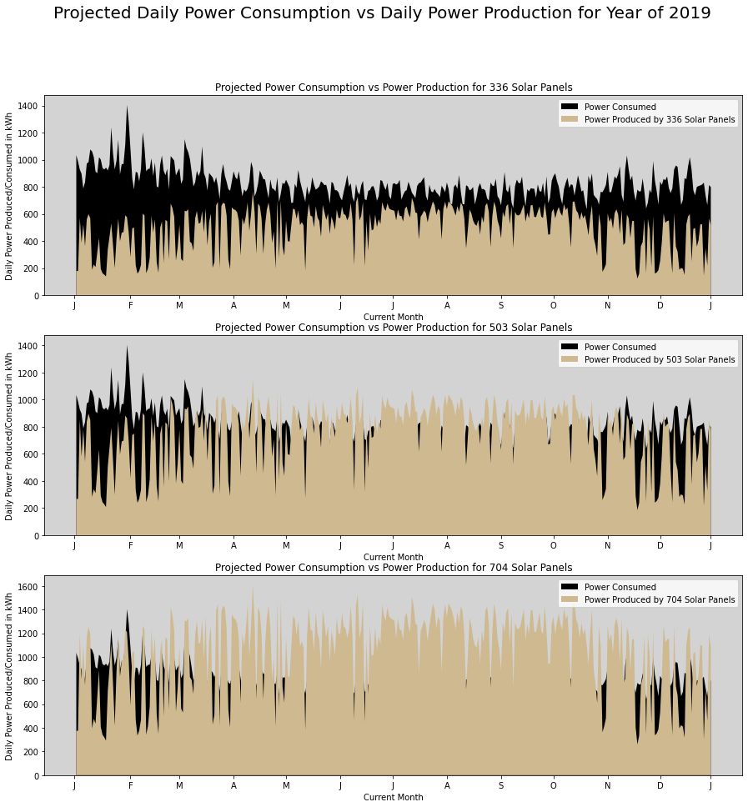
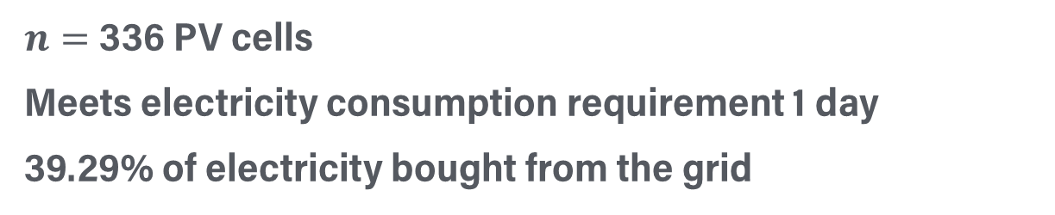
Results
$n=$336 PV cells
Meets electricity consumption requirement 1 day
39.29% of electricity bought from the grid

Slide 17
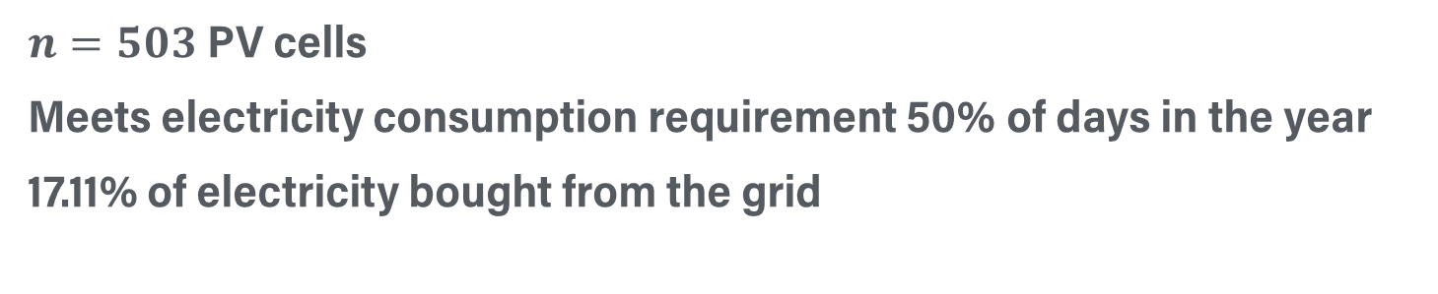
Results
$n=503$ PV cells
Meets electricity consumption requirement 50% of days in the year
17.11% of electricity bought from the grid

Slide 18
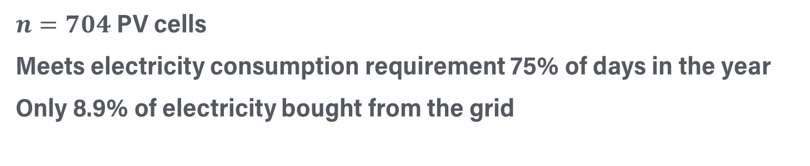
Results
$n=704$ PV cells
Meets electricity consumption requirement 75% of days in the year
Only 8.9% of electricity bought from the grid

Slide 19
Conclusion

Slide 20
Conclusion
Scope
Conduct analysis with electricity storage
Conduct cost analysis to identify viability of project
Account for power being sold back to the grid as a financial benefit
Add more universities to the training dataset
Test multiple types of PV cells

Slide 21
Conclusion
Conclusion
336 Solar Panels would cover 60% of the Lawson building’s electricity consumption in a year
503 Solar Panels would cover 83% of Lawson’s total consumption
704 Solar Panels would cover 92% of Lawson’s total consumption
These numbers help to conclude that there is a viable path to substantially decrease dependence on fossil fuels for electricity in Purdue University.
Notes:
We have 3 cases which we analyzed for.
336 Solar Panels would cover 60% of the Lawson building’s electricity consumption in a year
503 Solar Panels would cover 83% of Lawson’s total consumption
Fully powering the building for 183 days out of the 365 days in a year.
704 Solar Panels would cover 92% of Lawson’s total consumption
Fully powering the building for 274 days out of the 365 days in a year.
These numbers help to conclude that there is a viable path to substantially decrease dependence on fossil fuels for electricity in Purdue University and transition towards a greener and more ecofriendly university

Slide 22
Thank You

